Slide 1
TEAM BLOKUS
AI Project, Winter 2008
Brian Fish
Yong Shin

Slide 2
Blokus
A piece placement game for 4 players
Board is 20x20 squares
Each player starts with 21 “tetris-like” pieces
The object is to place all your pieces
Scoring- you lose 1 point per square for each tile you didn’t place
Based on the 4-color theorum

Slide 3
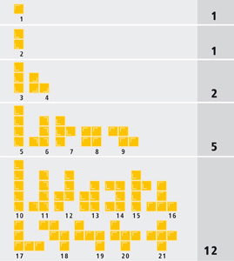
The Pieces

Slide 4

Tile placement rules
You must place corner to corner with your color.
You cannot have the body of one of your pieces adjacent to the body of another one of your pieces
Pieces of different colors can be adjacent.

Slide 5
Complexity
Each player can open with 44 different moves
Through the mid-game, players routinely consider 150+ moves per turn
150^4 = 506,250,000 combinations in 1 ply.
Complexity remains through the late-game, with fewer tiles, but potentially more spots to place them.

Slide 6
Our Approach
Phase 1: create the framework
  Board
  Player
  Piece placement logic
Phase 2: simple AI
  Random
  Middle
  Mid + Blocks + Corners

Slide 7
Our Approach (cont)
Phase 3: Look-ahead AI
  One ply
  Considers all moves
  Picks a move that results in the largest number of moves in the following round

Slide 8
Our Solution
Demo time baby!

Slide 9
Sample Results
score for Player1 (Mid/blocks/corners AI, M10, B10, C5) -18.552
score for Player2 (Mid/blocks/corners AI, M15, B20, C15) -21.832
score for Player3 (Mid/blocks/corners AI, M10, B15, C10) -26.14
score for Player4 (Random AI) -41.044
Averaged over 250 games
The best score was -3 by Mid/blocks/corners AI, M15, B20, C15
The worst score was -59 by Random AI
score for Player1 (Middle preference AI) -47.16
score for Player2 (Mid/blocks/corners AI, M10, B15, C10) -10.35
score for Player3 (Random AI) -35.06
score for Player4 (Look Ahead AI) -40.17
Averaged over 100 games
The best score was 20 by Mid/blocks/corners AI, M10, B15, C10
The worst score was -53 by Look Ahead AI

Slide 10
Future research
Balanced min/max for 4 players
Design algorithms that evaluate the board
Pruning
Designing the concept of space
Questions?

